Slide 1
Chatbot for Medical Diagnosis System
Information Systems Program
Team IS2
Under Supervision of
Assoc. Prof. Noha El-Attar
1-37
0-37

Slide 2
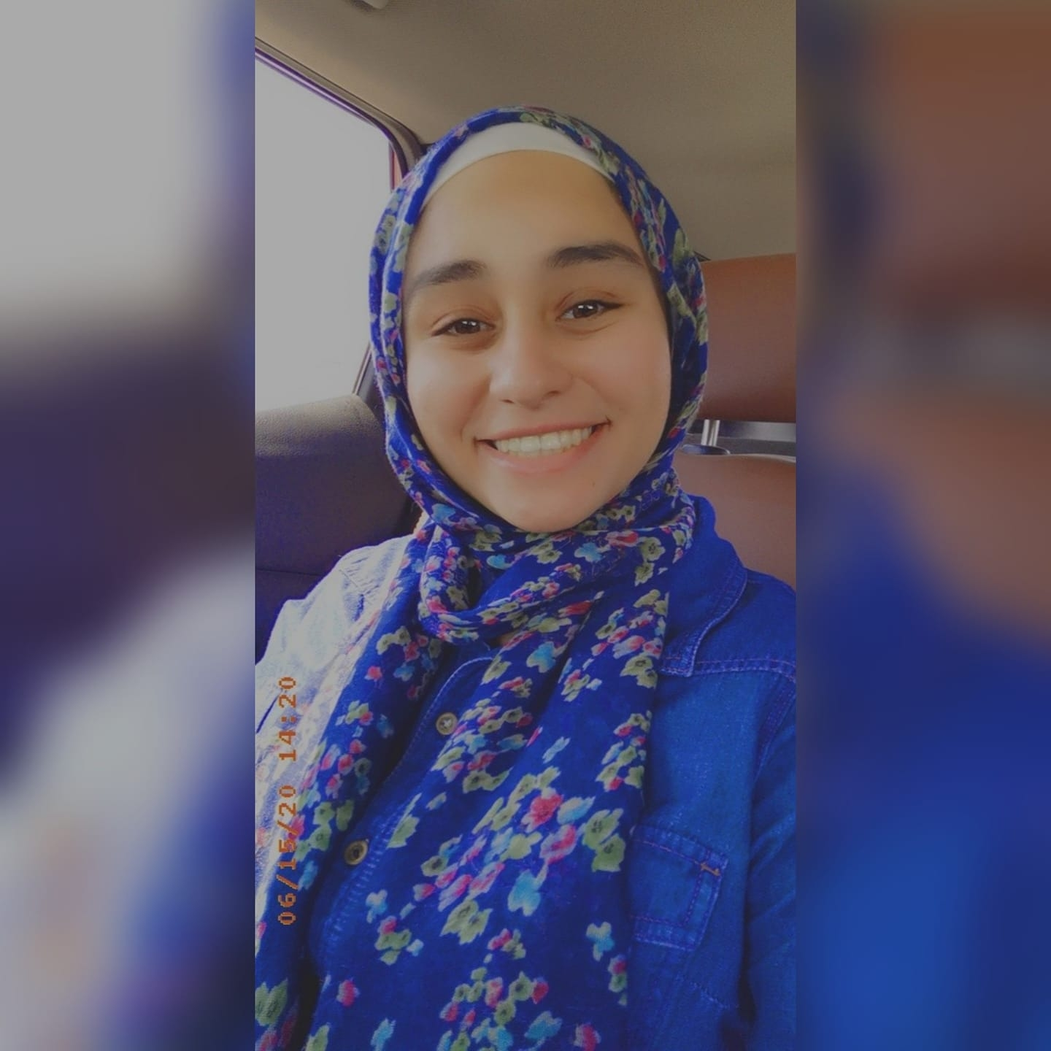
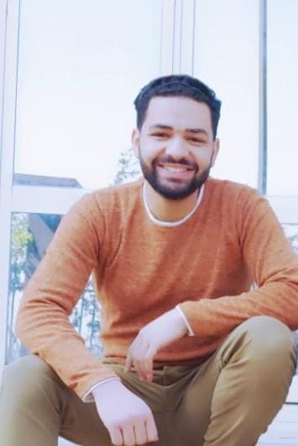
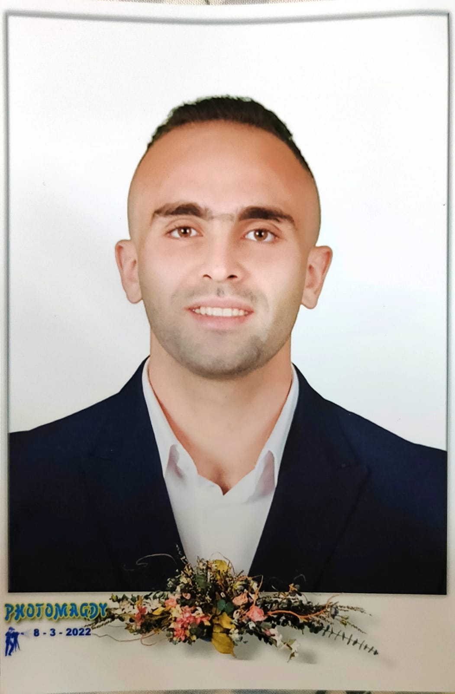
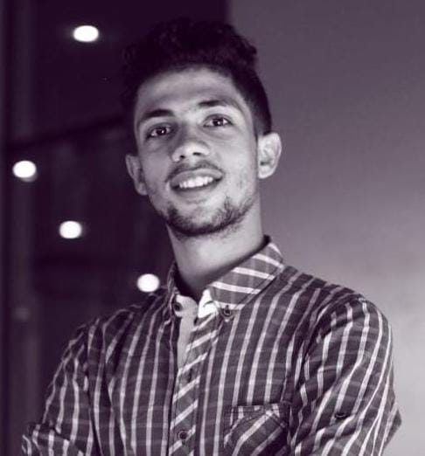
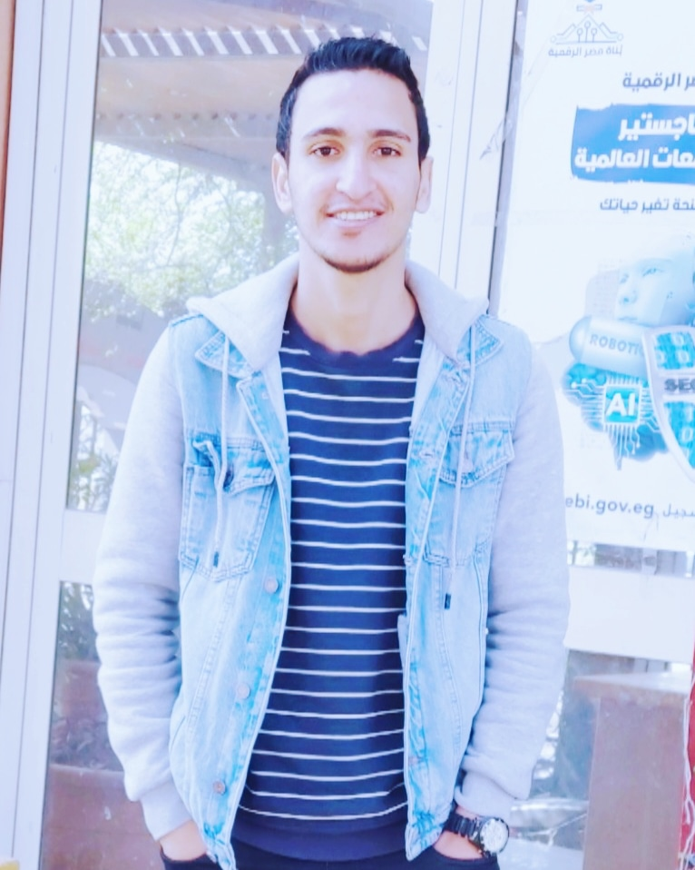
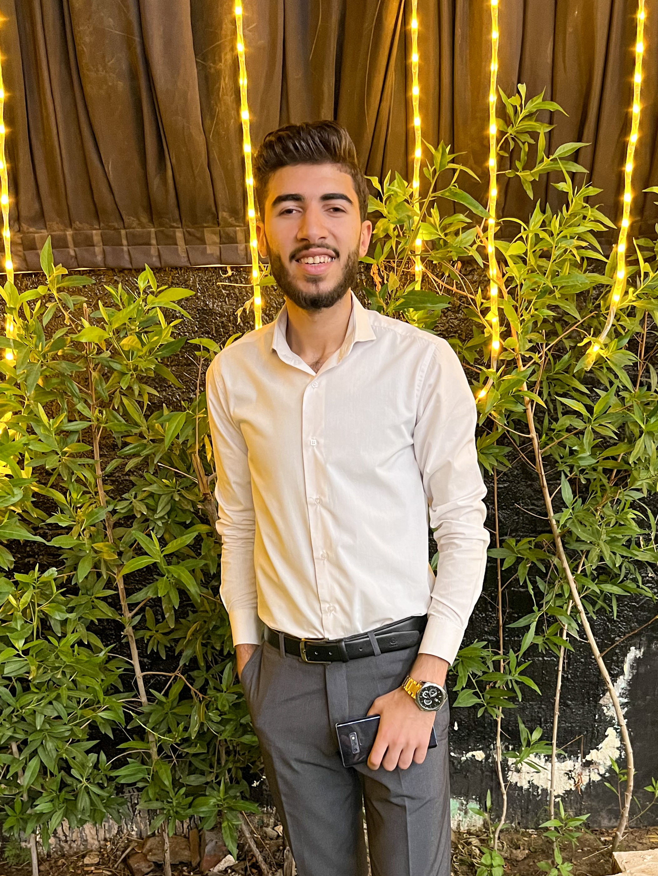
MEET OUR TEAM…
Mariam Mahmoud
Mohamed Tamer
Ali Lotfy
Mostafa Tarek
Abdelwahab Elshennawy
Khaled Zaky
2-37

Slide 3
TABLE OF CONTENTS
01.
Introduction
02.
Analysis diagrams
03.
System design
04.
Implementation
05.
Conclusion
Motivation
Object-oriented diagrams
Models , Front-end, Database
3-37

Slide 4
INTRODUCTION
Software applications that use textual conversational media are becoming increasingly common in healthcare entities.
In addition, through the lack of medical diagnoses chatbots globally, we were inspired to construct a simple, friendly, and interactive one.
4-37

Slide 5
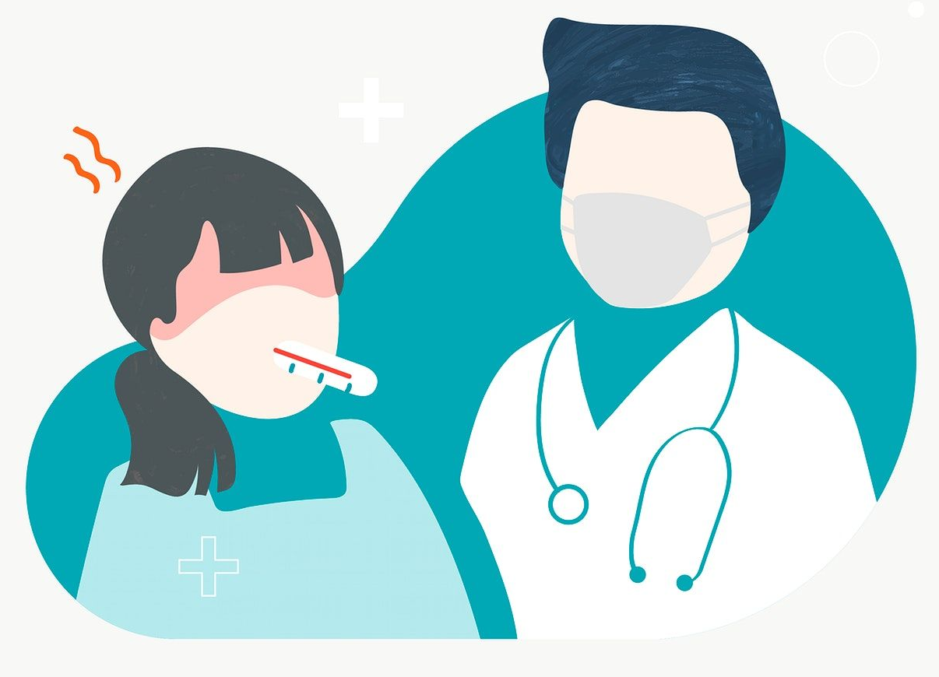
Doctors are frequently on a tight schedule, and being available immediately for every patient is often impossible.
Patients constantly visit with the same set of basic inquiries.
The patient is searching for a symptom on the internet but is confused where to go to know more.
5-37

Slide 6
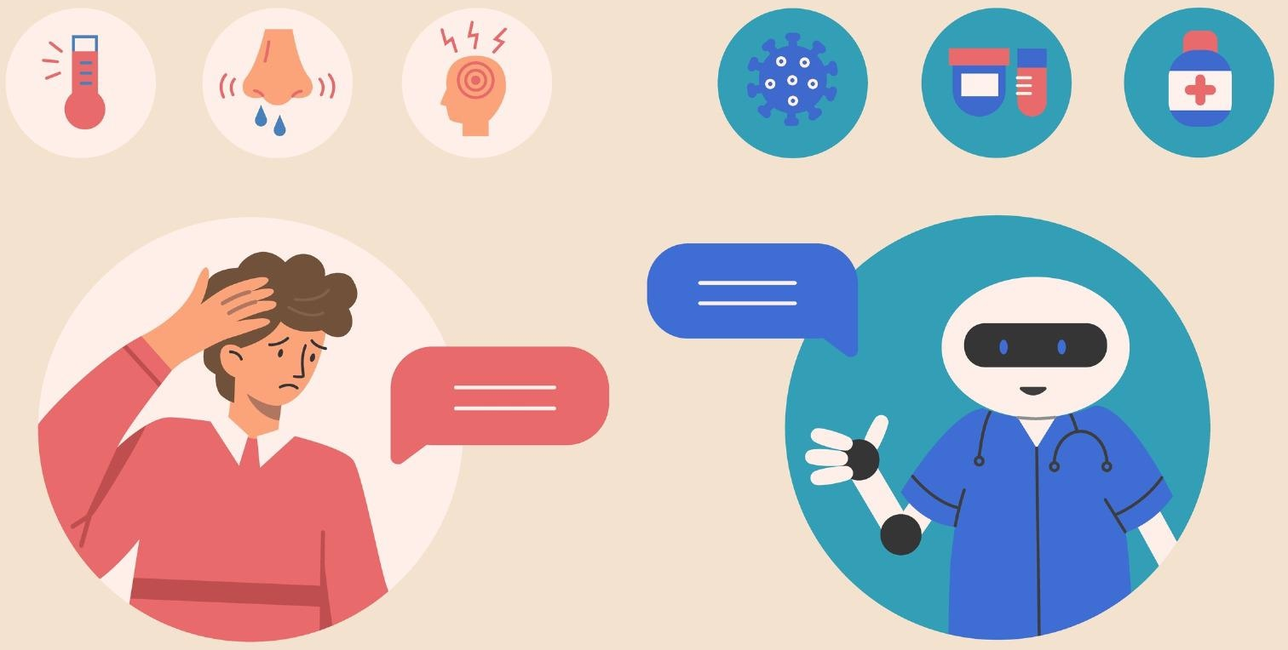
Acquire a preliminary diagnosis for diabetes.
Conversations
Match all current needs of users.
Stages & types
Symptoms
Diets & lifestyle
Treatments
What is it?
Deliver correct information immediately
Presenting basic information inquiries about diabetes.
Improving the patient experience
6-37

Slide 7
ANALYSIS DIAGRAMS
7-37

Slide 8
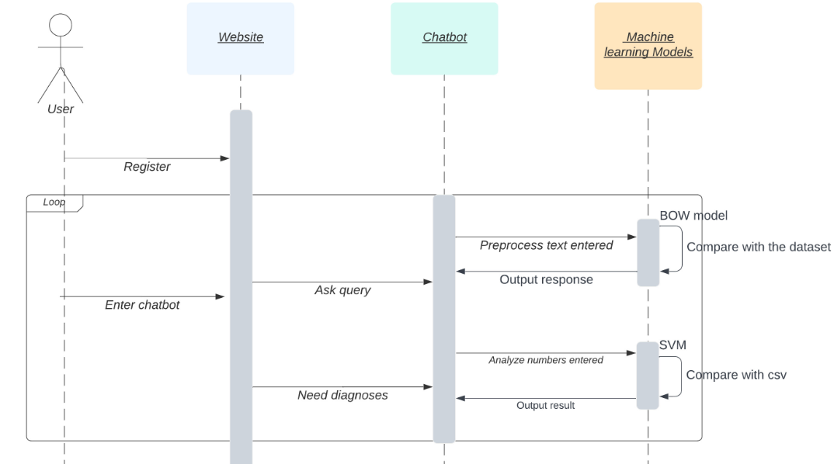
Sequence Diagram
8-37

Slide 9
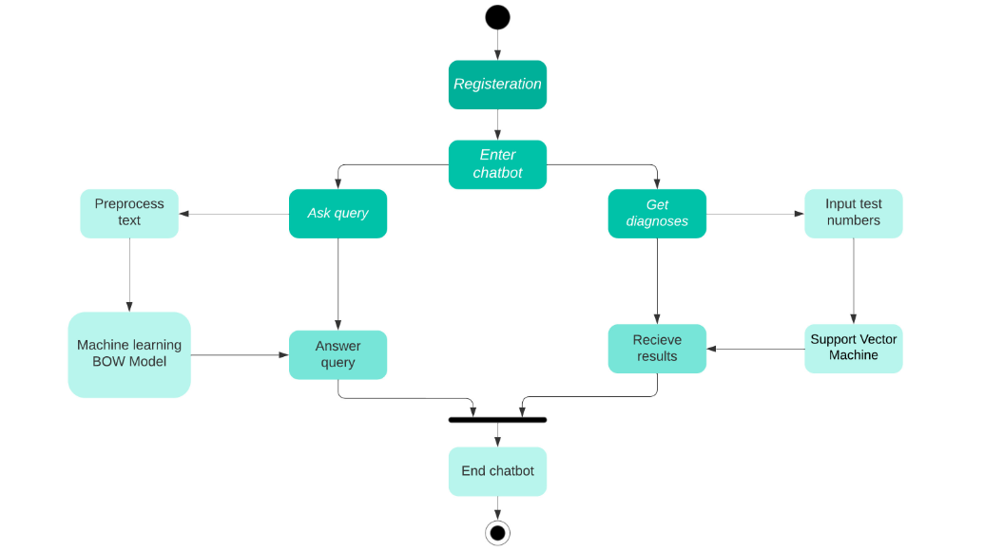
Activity Diagram
9-37

Slide 10
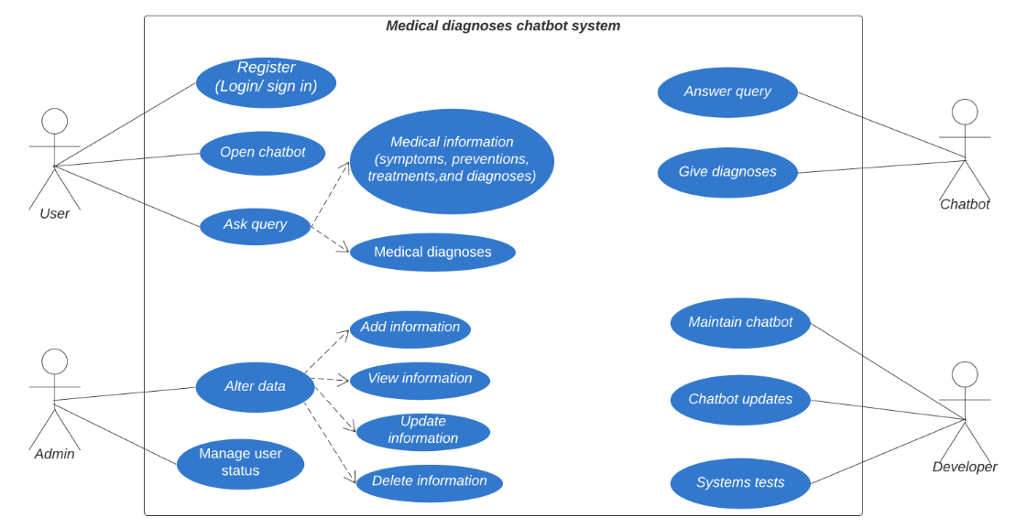
Use case Diagram
10-37

Slide 11
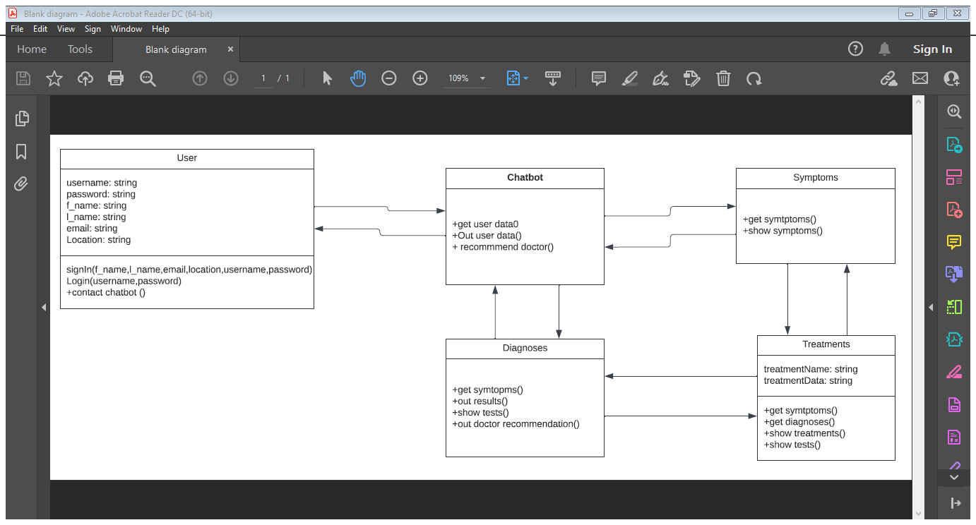
Class Diagram
11-37

Slide 12
System Design
12-37

Slide 13
System Design
Models
Front-end
Back-end
Chatbot
Website GUI
Website DB
13-37

Slide 14

Models
14-37

Slide 15
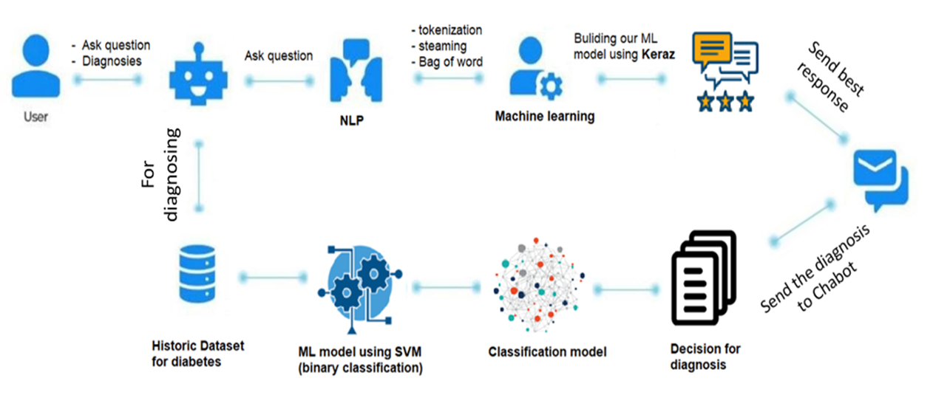
FIRST MODEL
SECOND MODEL
Automatic response based on text similarity
Automatic diagnoses response based on learning classifier
15-37

Slide 16



Models architecture
Dataset
Data preprocessing
Split the Dataset
Building the model
16-37

Slide 17
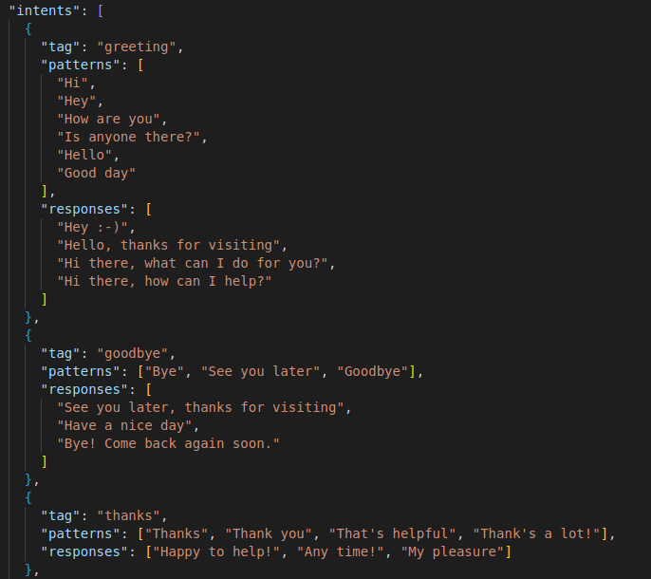
Frist MODEL
Data set
1
json file
Divided into contains categories (intents), pattern and responses.
will give a random response
17-37

Slide 18
Tokenization : splitting a string into meaningful units
“ I want to know if I have diabetes or not”
[“ I” , “want” , “to” , “know” , “if” , “have” , “diabetes” , “or” , “not”]
Preprocess data
2
Stemming : generate the root form of the words
[“ visiting” , “production”] [“ visit” , “produce”]
Tokenizing
Remove duplicate words
Steaming
BOW
Split data
(train ,test)
BOW : will convert text into numbers to apply a neural network algorithm
[ I, want , to , know , if , I , have , diabetes , or , not , you]
“have diabetes or not ” : 0 0 0 0 0 0 1 1 1 1
“if you want ” : 0 1 0 0 1 0 0 0 0 1
18-37

Slide 19
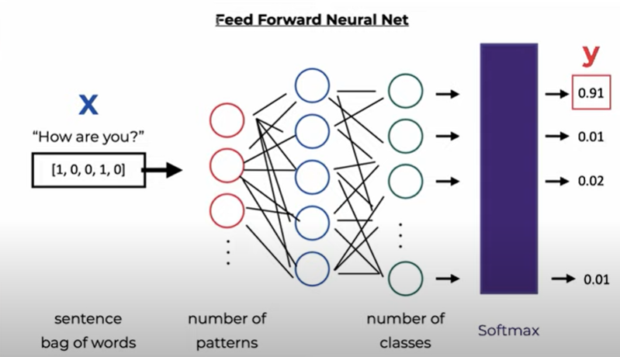
19-37
Build Model
First layer: have 128 neurons
Second layer: have 64 neurons
Third layer: have the same number length of one element of train Y
3
Neural-network using Keras
Architecture model
Compile the model
Fit model
Epochs 200

Slide 20
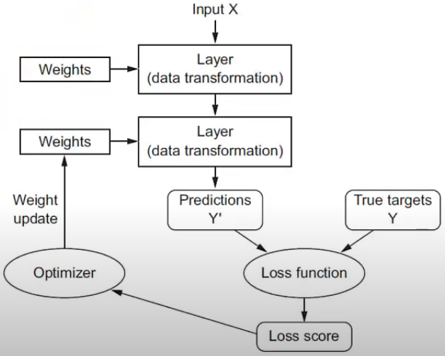
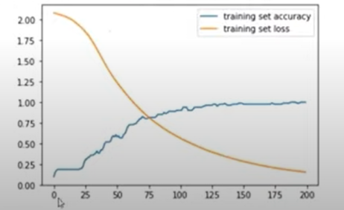
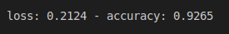
Build Model
3
Neural-network using Keras
Architecture model
Compile the model
Fit model
Epochs 200
Accuracy 92
Loss .2

Slide 21
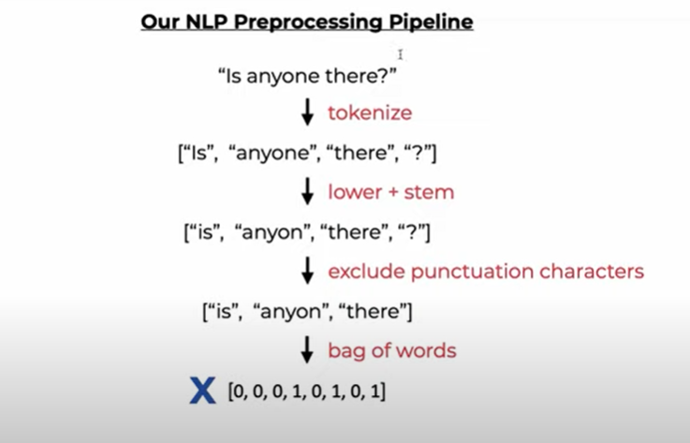
User input
4
Tokenizing
Steaming
BOW
Predict pattern
Random response
Predict pattern
Takes input and returns a list that contains a tag corresponding to the highest probability (THERSHOLD = .5)
Random response
Choose a random response corresponding to the same tag in intent.json.
20-37

Slide 22
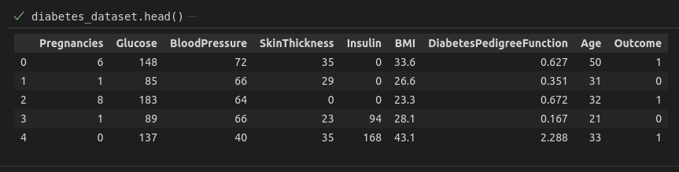
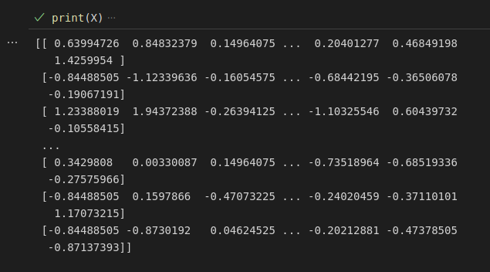
Second Model
Dataset
Data preprocessing
National Institute of Diabetes and Digestive and Kidney Diseases
To make training faster
Handling Missing
duplicated data
visualize the dataset
Data Transformation (Normalization)
consists of several medical predictor variables ( insulin level, age, and so on.)
Outcome
21-37

Slide 23
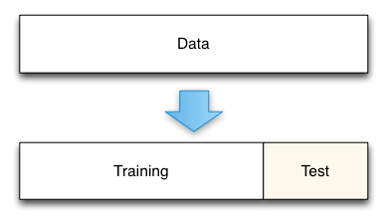
Dataset
Data preprocessing
Split the Dataset
National Institute of Diabetes and Digestive and Kidney Diseases
To make training faster
Estimate the performance of ML algorithms
Handling Missing
duplicated data
visualize the dataset
Data Transformation (Normalization)
consists of several medical predictor variables ( insulin level, age, and so on.)
Outcome
Scikit-learn library
Train Dataset: to fit the model.
Test Dataset: to evaluate the fit model
22-37

Slide 24

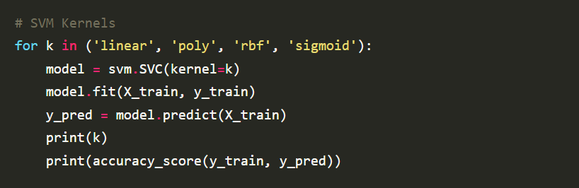
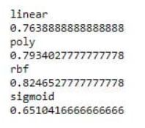
Faster prediction
better accuracy
memory efficient.
better computational complexity.
Execution time is very little.
Building the model
To produce Classification model
To create the SVM classifier, we will import SVC
we have different kernels to build the model (linear , poly , sigmoid)
Accuracy 82% from (radial basis function)
Save our model into pickle file.
23-37

Slide 25
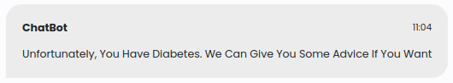

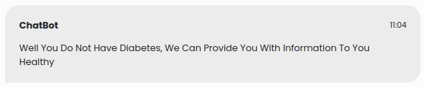
Making a Predictive System
Predicted outcome
Input data from user
Preprocessing data
Prediction using the created model
Predicted outcome
In case user has diabetes
In case user don’t have diabetes
How to connect between 2 models ?
24-37

Slide 26
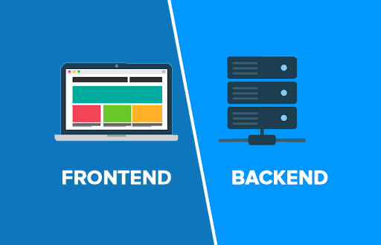
Website Front-end
25-37

Slide 27
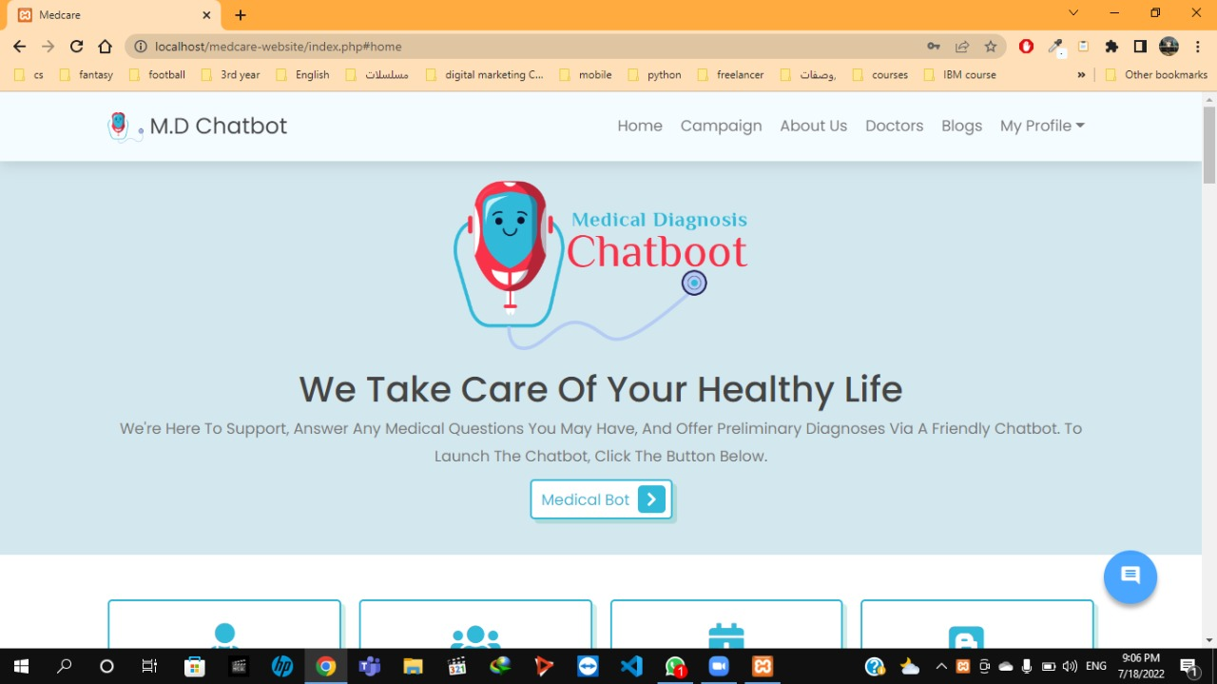
Front-end for user
Design of website:
All the web In one page to make it easy for user to get help quickly and not to be disturbed.
It is divided in to 5 section tags <> .
Colors of website:
we choose light blue as our web relates to medical purposes .
Logo:
It present what we serve as our website is a medical d. chatbot.
26-37

Slide 28
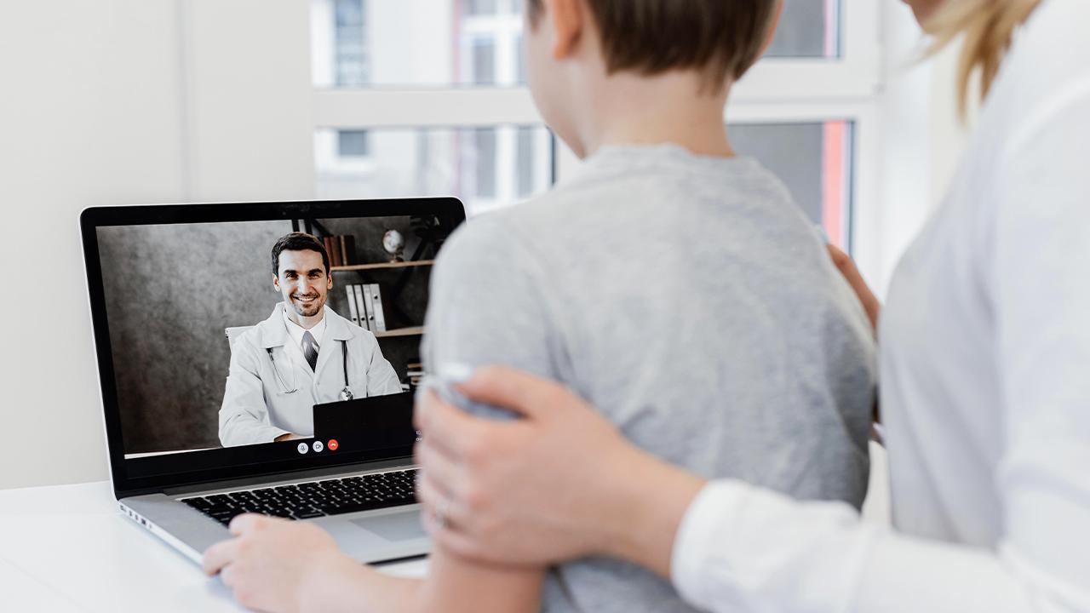
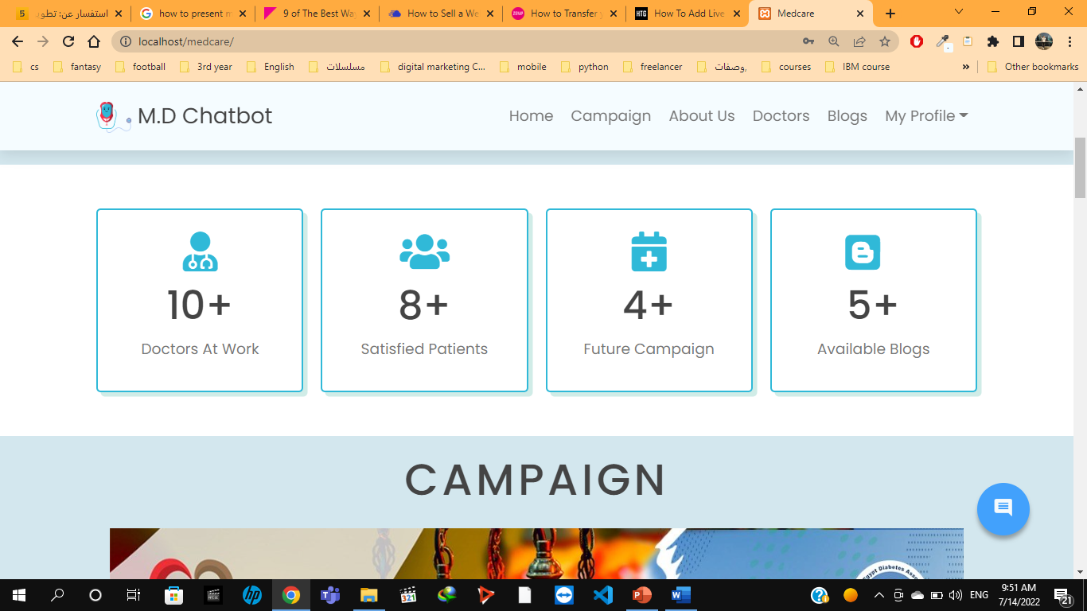
Numbers of doc, users, campaigns, available blogs (to gain user confidence by showing him number of available data)
27-37

Slide 29
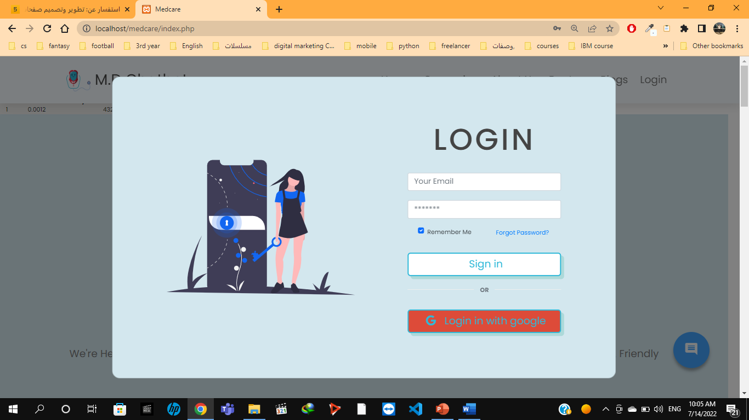
Login form
1. Popup window 2. Quick sign up
28-37

Slide 30
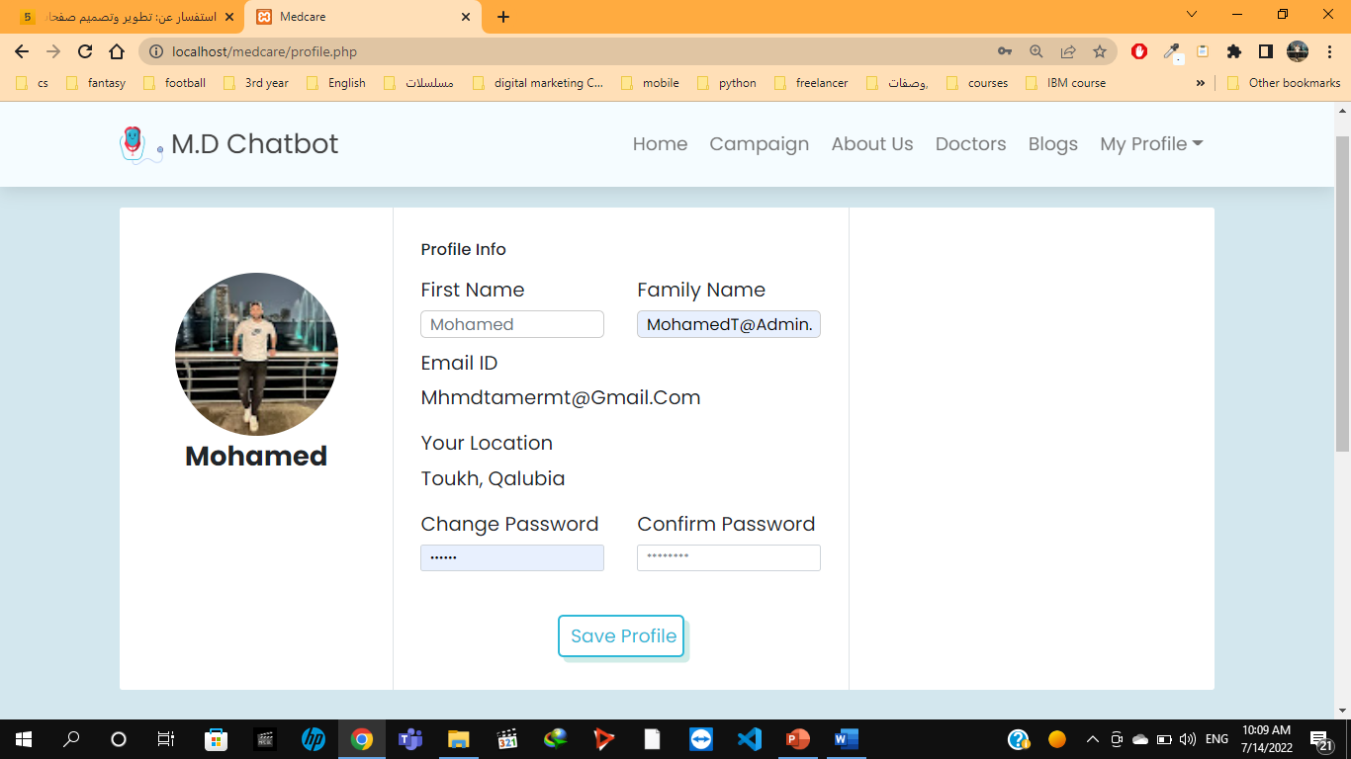

User profile:
1. Show personal data
2. Update his personal data
29-37

Slide 31
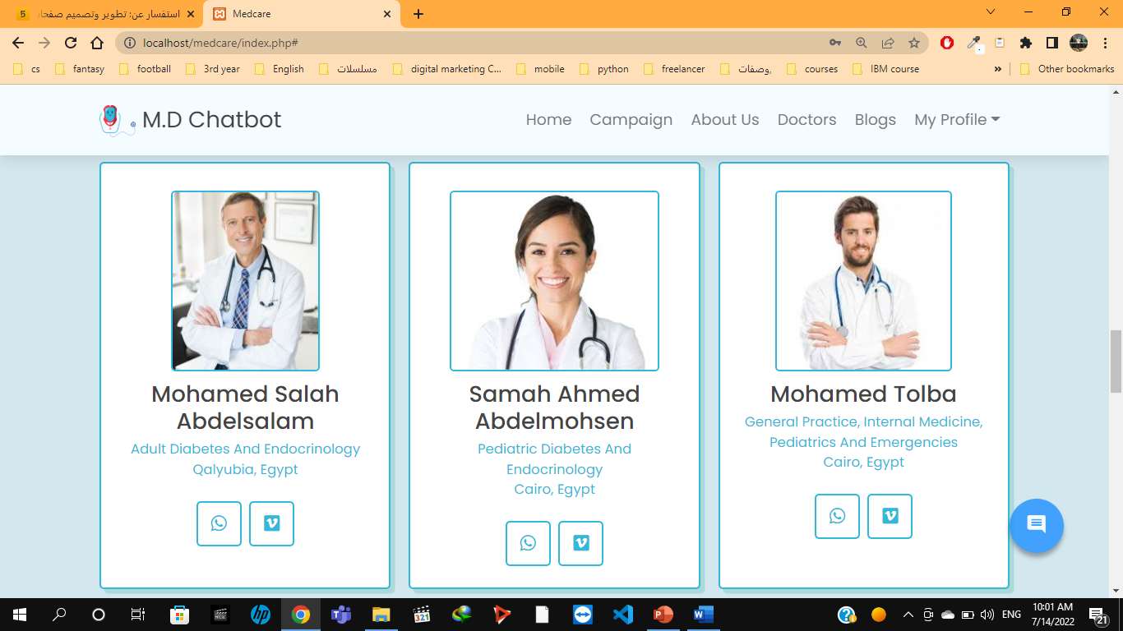
Doctor section we show up our doctors (to the patient and help them to contact the docs)
- WhatsApp link -Vezeeta -link Location
30-37

Slide 32
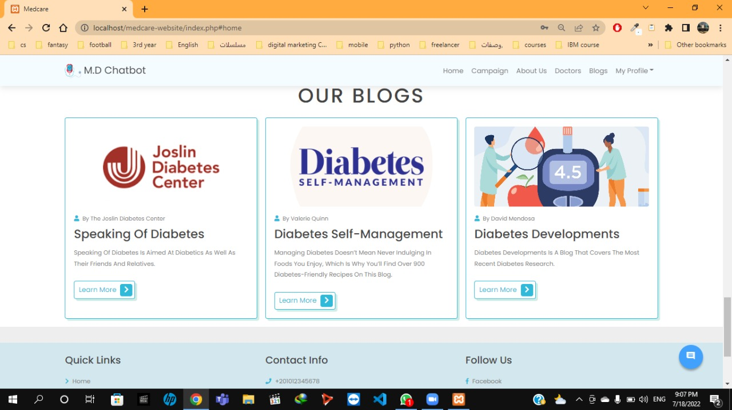
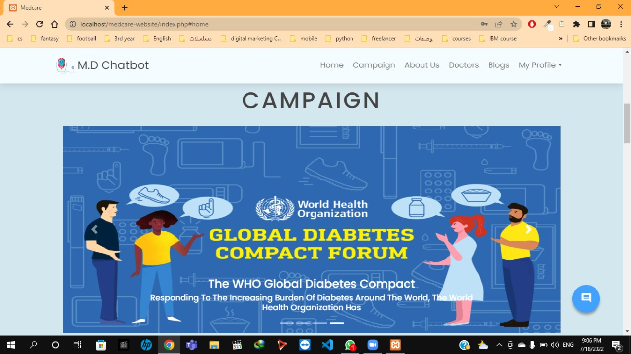
Blogs sections
1.Link to the blogs
2.Description of blogs
3.Author
In this section we present to the user the campaigns available about the diabetes for the next few months
31-37

Slide 33
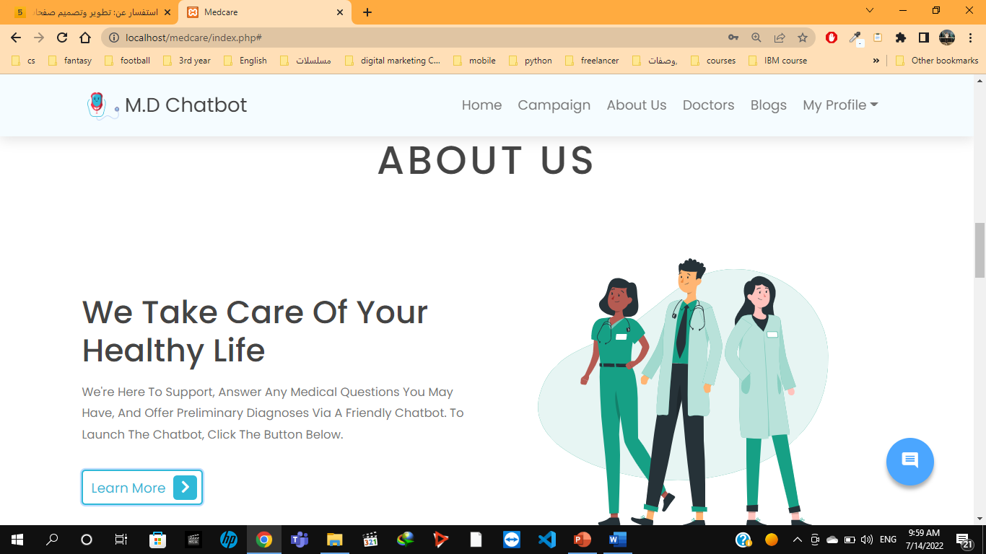
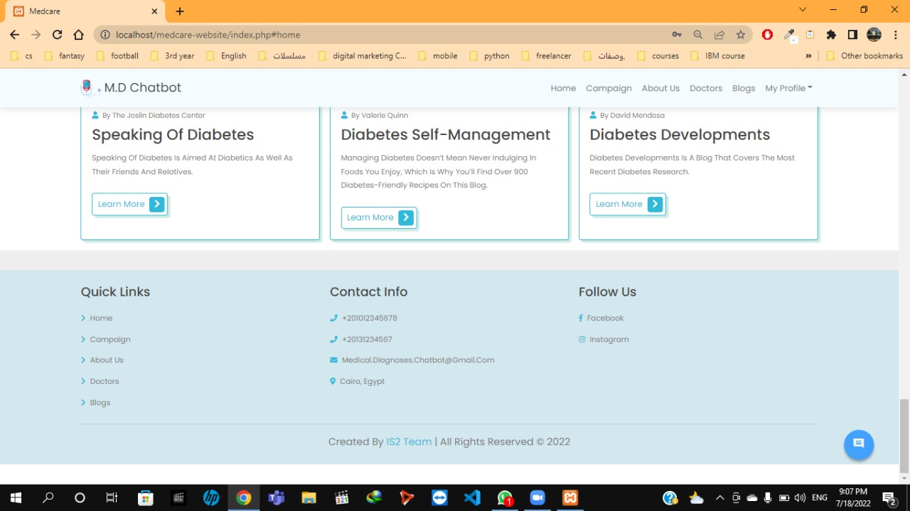
About us section some info about the website owners and how to contact with them
32-37

Slide 34
Back-end
33-37

Slide 35
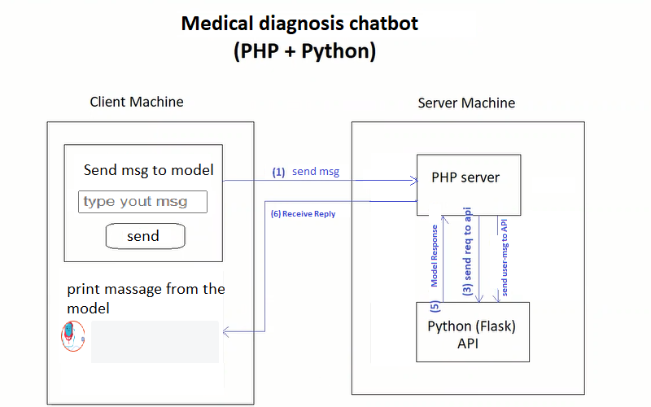
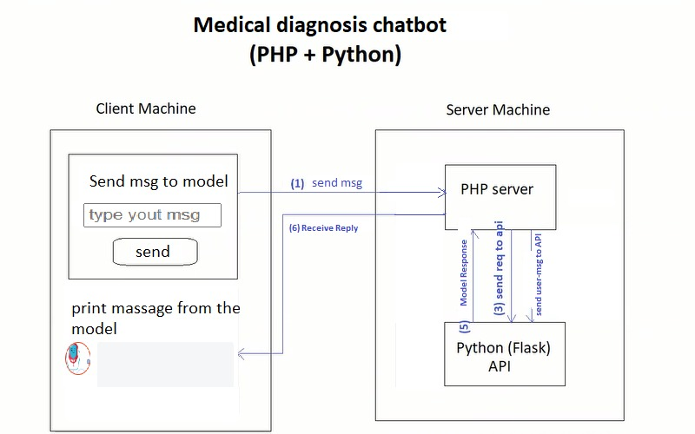
Flask API
Get user msg
Send msg to php server
Connect to flask server
Flask API receive the msg from post method request
Flask send the msg to the model
The model return the reply
The flask send the reply to the php server
The php server print the reply to the user throw the html
34-37

Slide 36
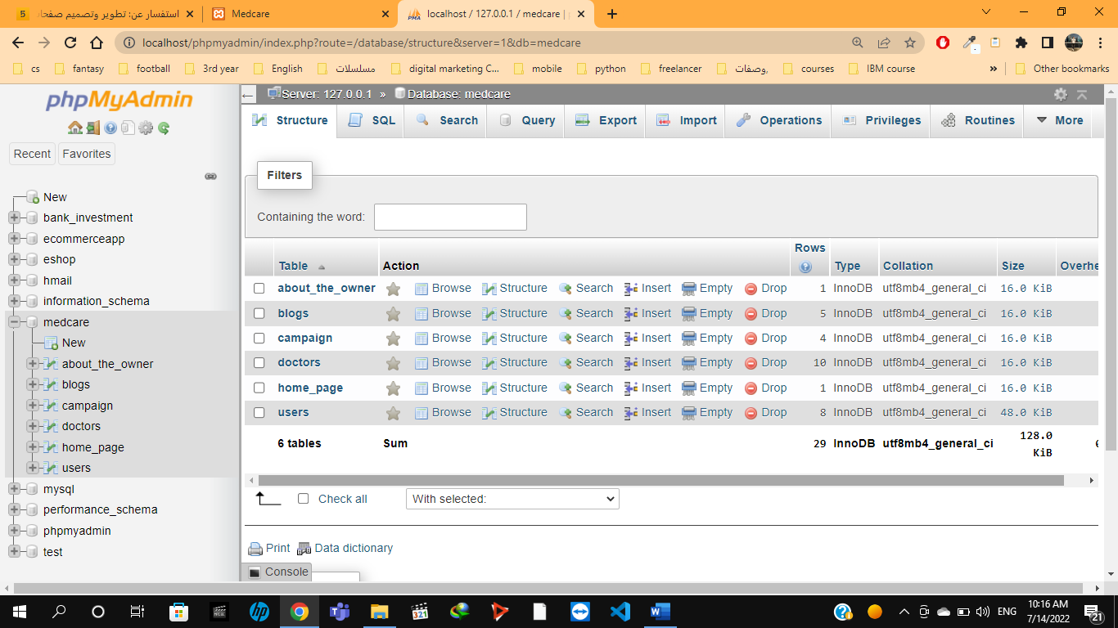
User Back-end (PHP, MySQL)
Tables of database
6 tables
Data of the users and doctors
Data of campaigns and blogs
Data of website owners
Crud operations
View all the data from the database on website pages
Updating user data if he needs
Sign up
We use email to make it easy for the user to sign up
35-37

Slide 37
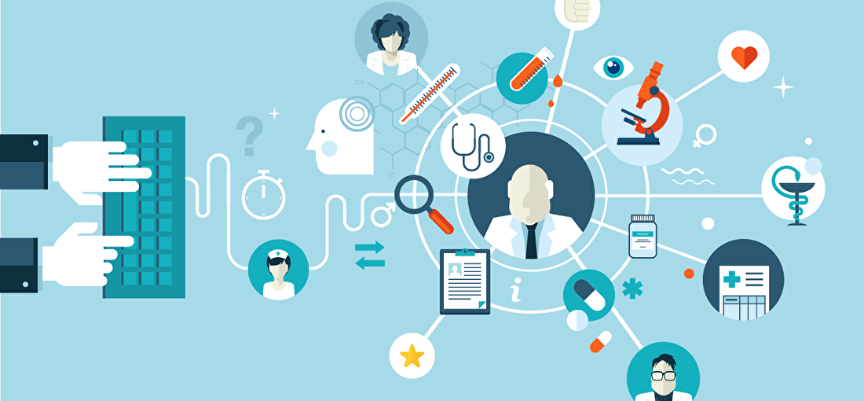
IMPLEMENTATION

Slide 38

Git control

Slide 39
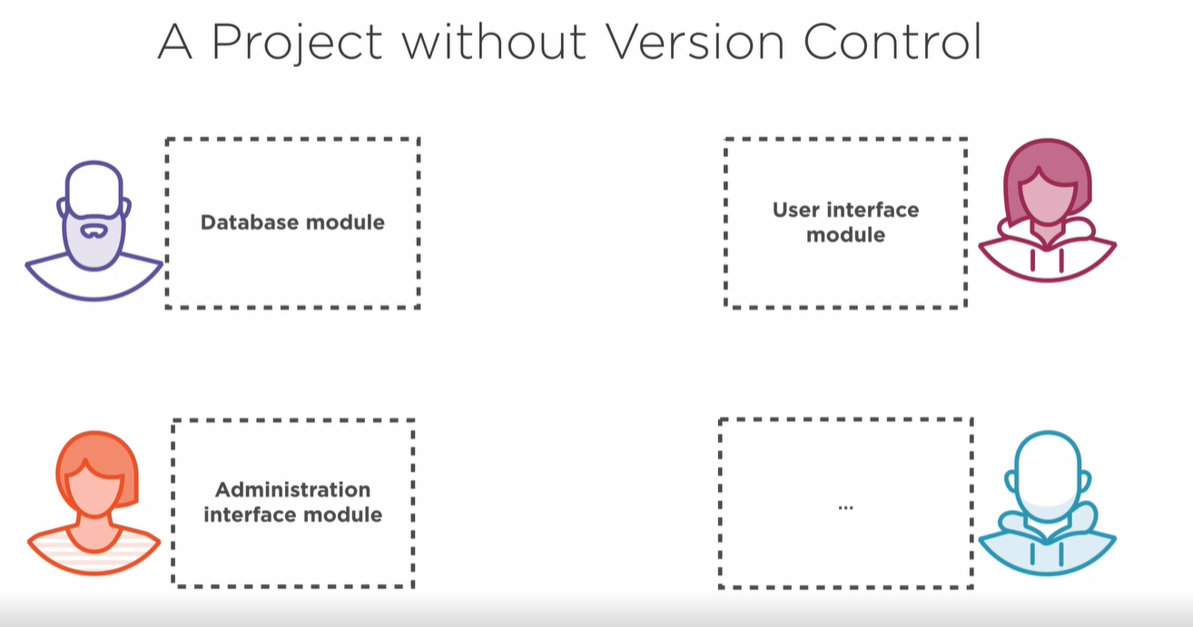
NLP Model
SVM Model

Slide 40
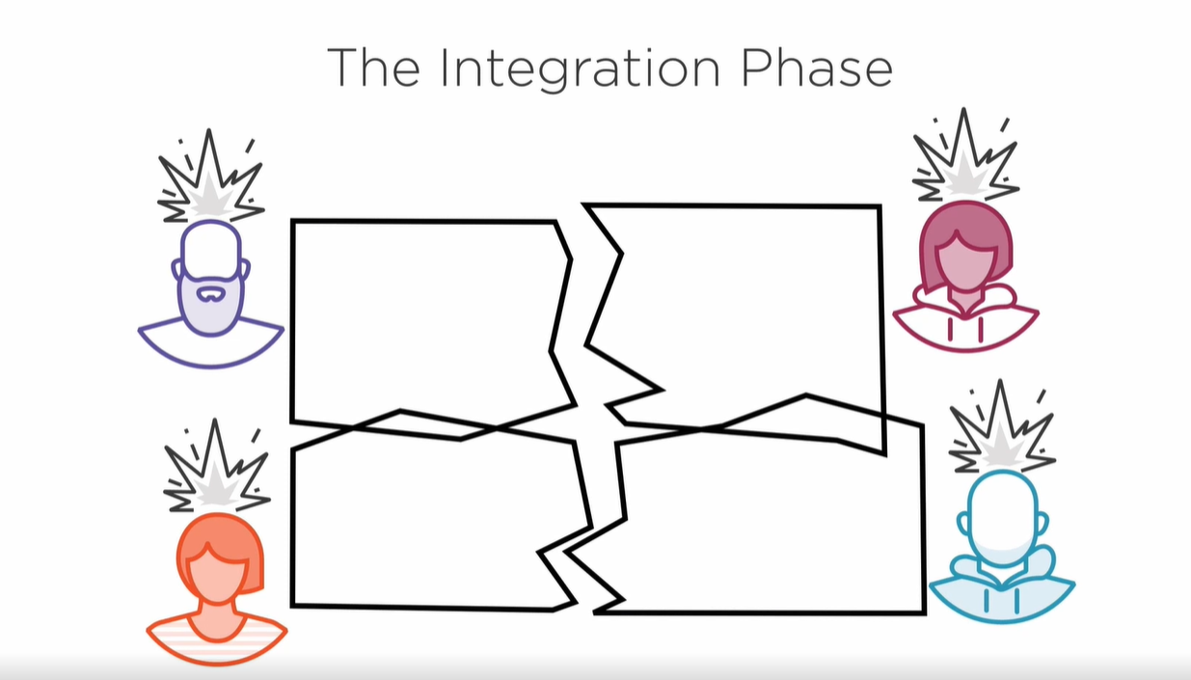

Slide 41
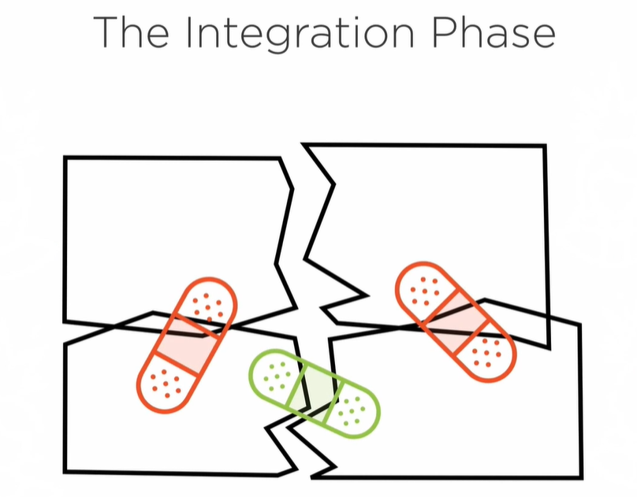

Slide 42
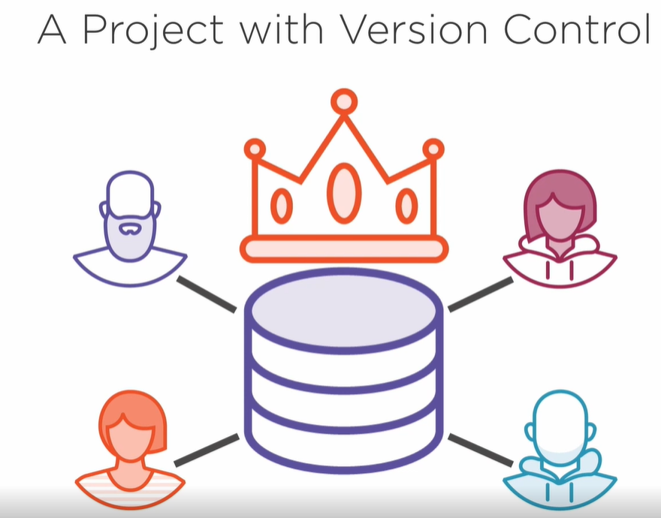
Developers working in the same code
hosted on the internet.
Backup
Merge changes automatically
Merge conflicts
History of changes
https://github.com/abdelwahab3/Chatbot-for-Medical-Diagnosis-System

Slide 43
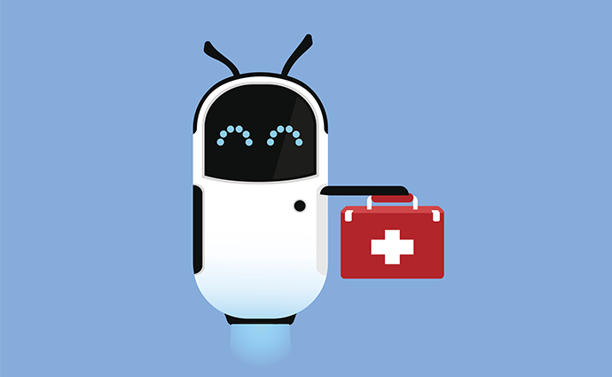
CONCLUSION
The project focuses on providing rapid medical services from knowing basic information reaching to diagnoses; this service is conducted through an intelligent chatbot.
The chatbot works on two models, one is based on text similarities the other is based on learning classifier.
36-37

Slide 44
Thank You
We appreciate the time given to us …
37-37

